Slide 1
Tourist Advisor
Coursera Data Science Project

Slide 2
Introduction
Problem Statement - Travel Planning
Challenges
Unknown place / Limited knowledge
Tasks
Identify the popular places to visit
Visit all the places within the given days of stay
Optimize the number of places that can be covered per day
Prepare the itinerary for each day
Tourist Advisor
Help the tourist
Takes City to be visited and the number of days of stay as input
Prepare the day to day itinerary

Slide 3
Data used
Geocoders
To get latitude and longitude of the city
Foursquare
List of travel categories (venues/categories)
List of venues (venues/explore)
Venue Details (venues/VenueID)

Slide 4
Methodology
Step 0: Input the City being visited and the number of days of stay
Step 1: Using geocoders Nominatim MAP APIs find the latitude and longitude values of the City.
Step 2: Using Foursqaure Venues/Categories API, get the list of supported venue categories.
Step 3: Filter tourist attractive categories from the response.
Step 4: Display the tourism categories to the user, so that he can select the categories of interest to him.
Step 5: Using the Foursqaure Venues/explore API, get the list of Venues matching selected tourism categories.
Step 6: Convert the response received in the json format to Dataframe with columns: ‘Venue Name’, ‘ID, ‘Category’, ‘ Latitude’ and ‘Longitude’.

Slide 5
Methodology
Step 7: Using the Foursquare Venues/VenueID API get the details of each travel venue. Add the columns ‘Rating’, ‘Likes’ to the dataframe based on the values received from the Venue Details.
Step 8: Sort the dataframe based on the Rating and Likes. Pick up top N travel venues. The number N is derived from the duration of the stay.
Step 9: Create a new dataframe by dropping ‘Venue Name’, ‘Id’, ‘Category’, ‘Rating ‘ and ‘Likes’ columns. The dataframe would be having only Latitude and Longitude columns now.
Step 10: Use K-Means clustering to segment venues based on the Latitude and Longitude values. Number of clusters is equal to the number of days of stay.
Step 11: Display the list of venues in each segment. (The itinerary for each day)
Step 12: Use Folium to visualize the travel venues on the City map. Choose a color for each segment and mark the places with the segment color.

Slide 6
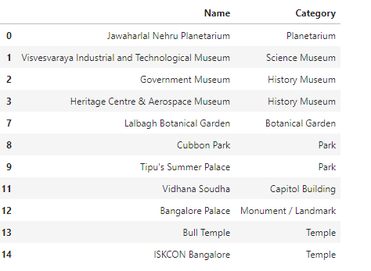
Results
City to be Visited: Bangalore, India
Days of stay : 3
Day 1 Itinerary

Slide 7
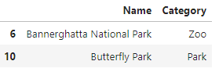

Results
Day 2 Itinerary
Day 3 Itinerary

Slide 8
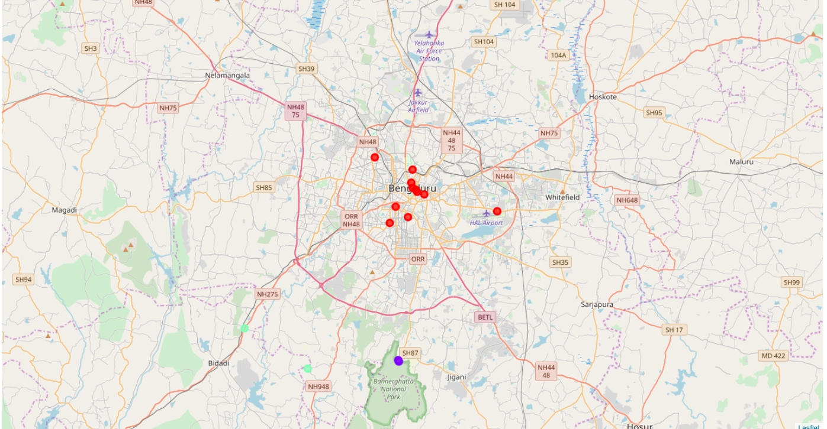
Results

Slide 9
Observation
Places inside the city are covered on Day1
Places around the city are covered on Day 2 and Day 3
On Day 2 places on the South West part of the city is covered.
On Day 3, places on the South part of the city is covered.
Scope for improvement:
parameters like, typical hours spend on each venue by users can be included in the logic for planning.

